Slide 1


Project Black Sky: Watching the Watchers
Suspicious skies, revealed.

Slide 2
Problem Statement & Objectives
Space is getting crowded: 9,000+ active satellites, thousands more objects.
Risks: suspicious maneuvers, collisions, uncoordinated activity.
Need: transparent, data-driven tools to spot anomalies early.
Our Objective: build an open-source pipeline to flag unusual satellite behavior and empower equitable access to space situational awareness.
Notes:
As satellites multiply, space is becoming more crowded and complex. Suspicious maneuvers or unreported activities can raise risks of conflict or collision. Today, much of this monitoring is locked behind closed doors. Our goal is to build an open, data-driven system that can flag unusual satellite behavior early and make space situational awareness more transparent and accessible to everyone.

Slide 3
Methodology
Data engineering
Fetched and cleaned TLE/GP history for 180 days
Deduplicated by NORAD ID and latest epoch
Merged with UCS metadata
Feature Engineering
Physics-informed features from harmonized TLE/GP data
Special focus on RAAN drift vs. J2 perturbation model
Anomaly Detection
Isolation Forest

Slide 4
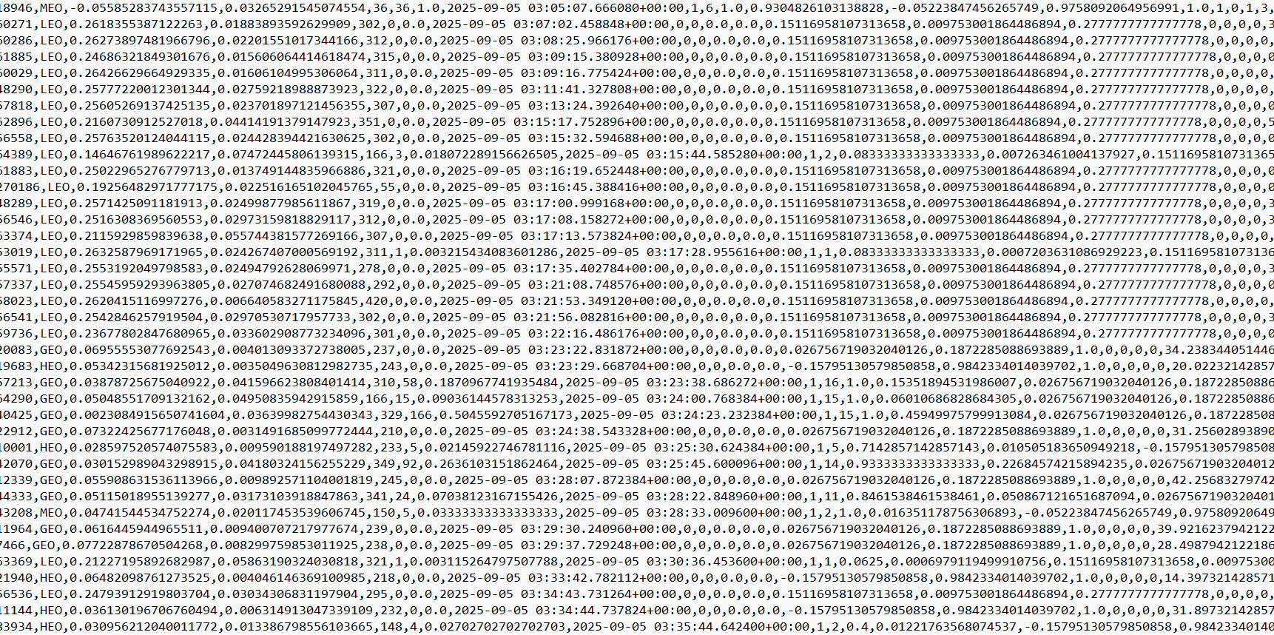
anomalous_rows.csv
scores.csv
dailies.csv

Slide 5
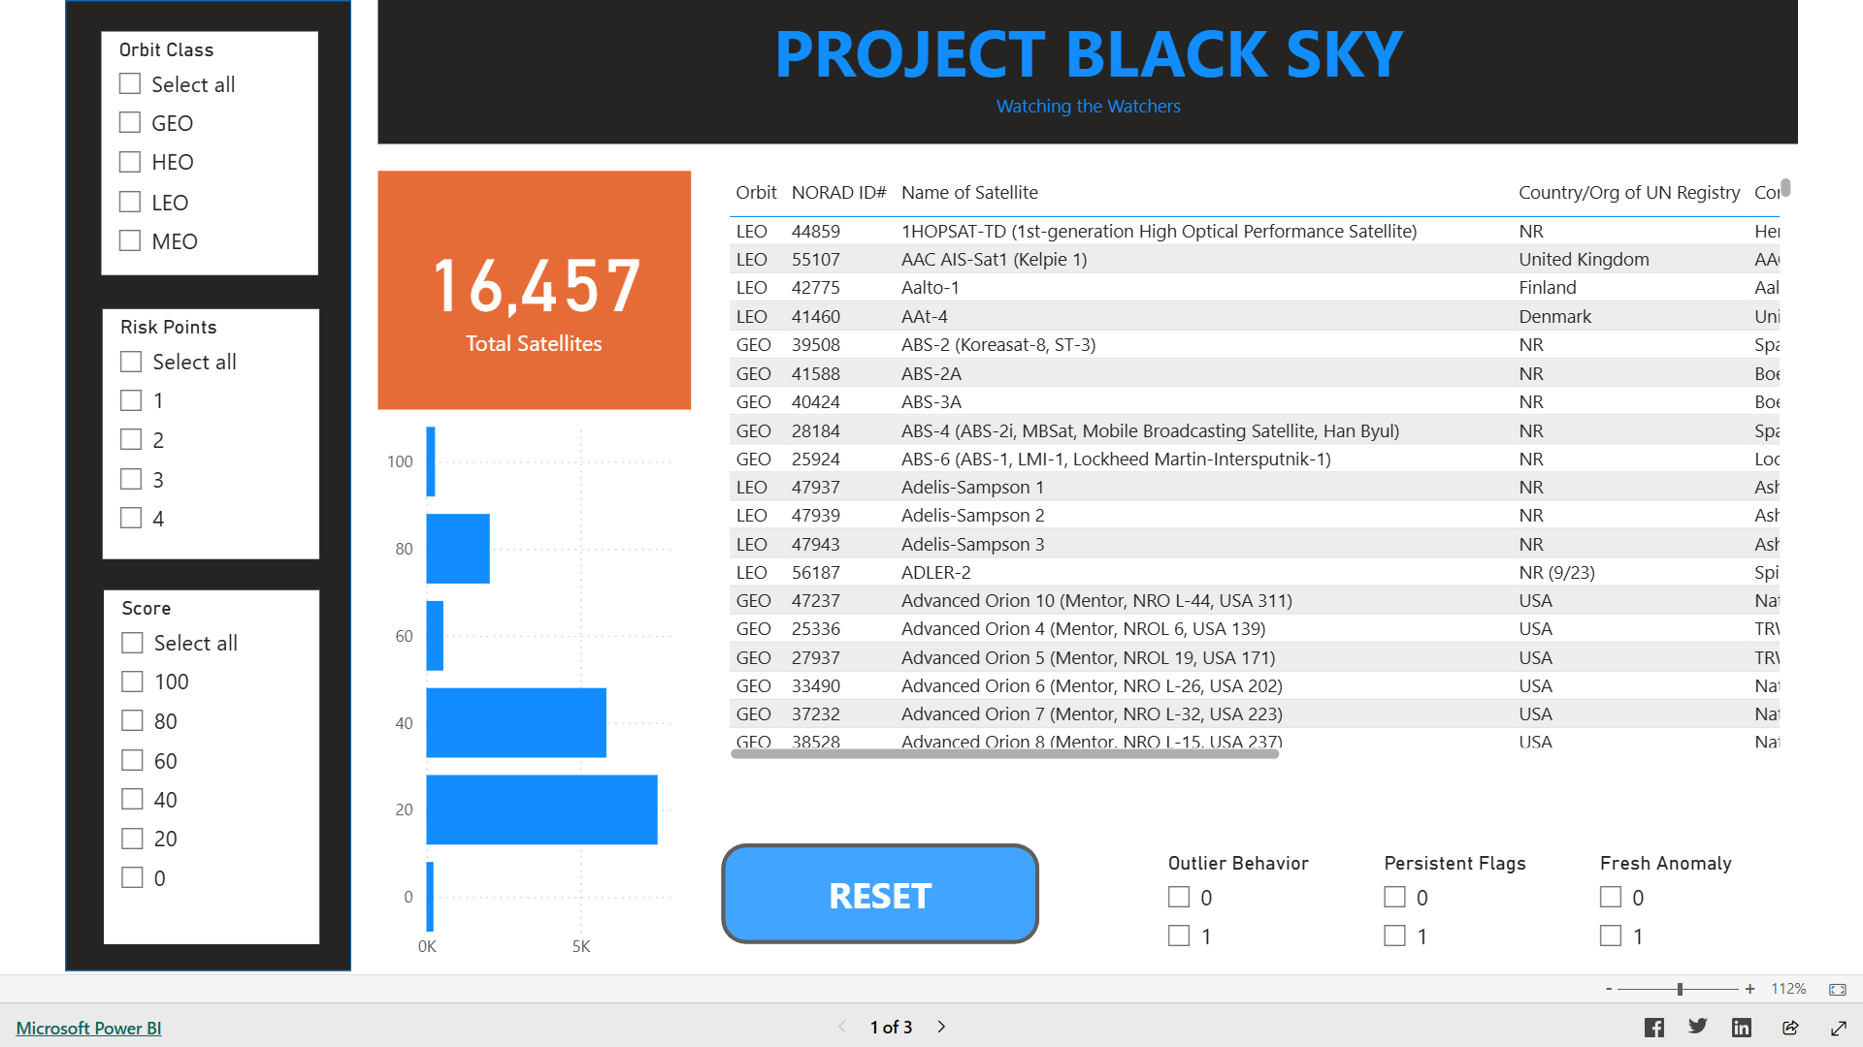

Slide 6
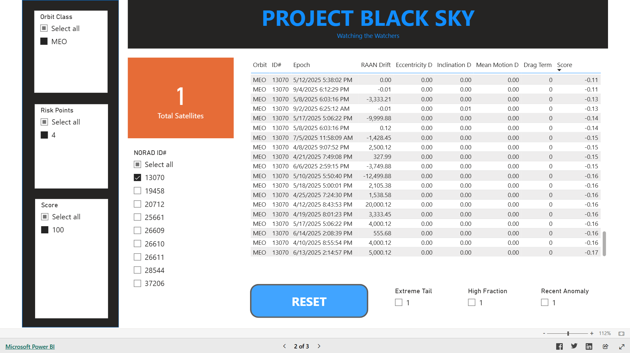

Slide 7
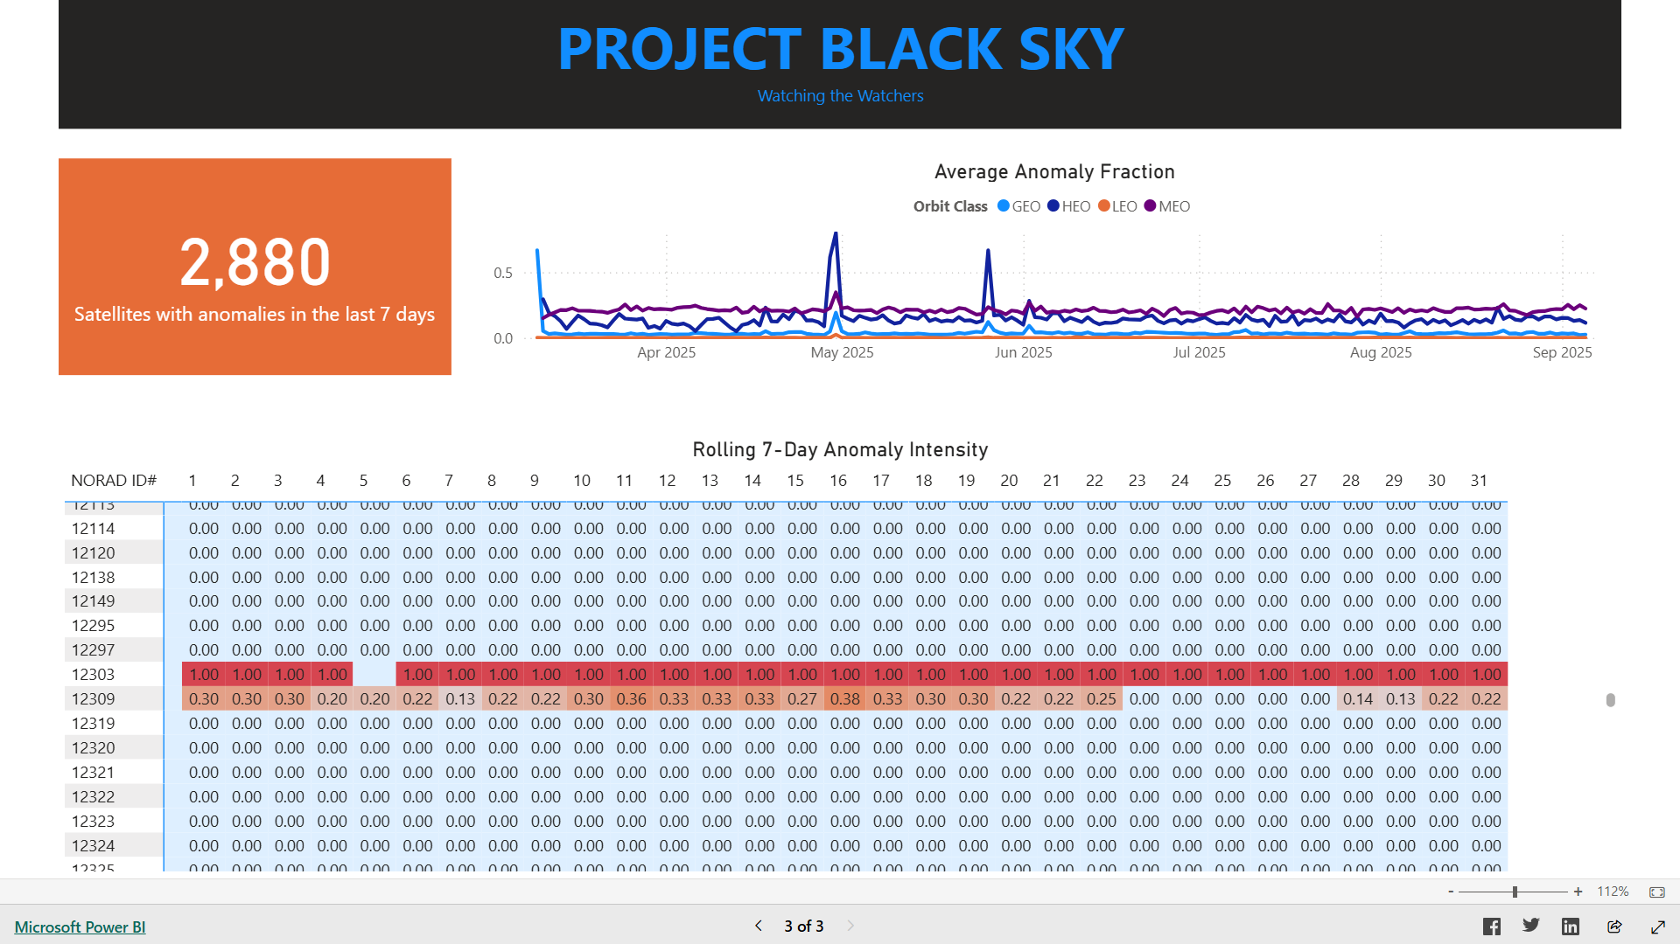

Slide 8
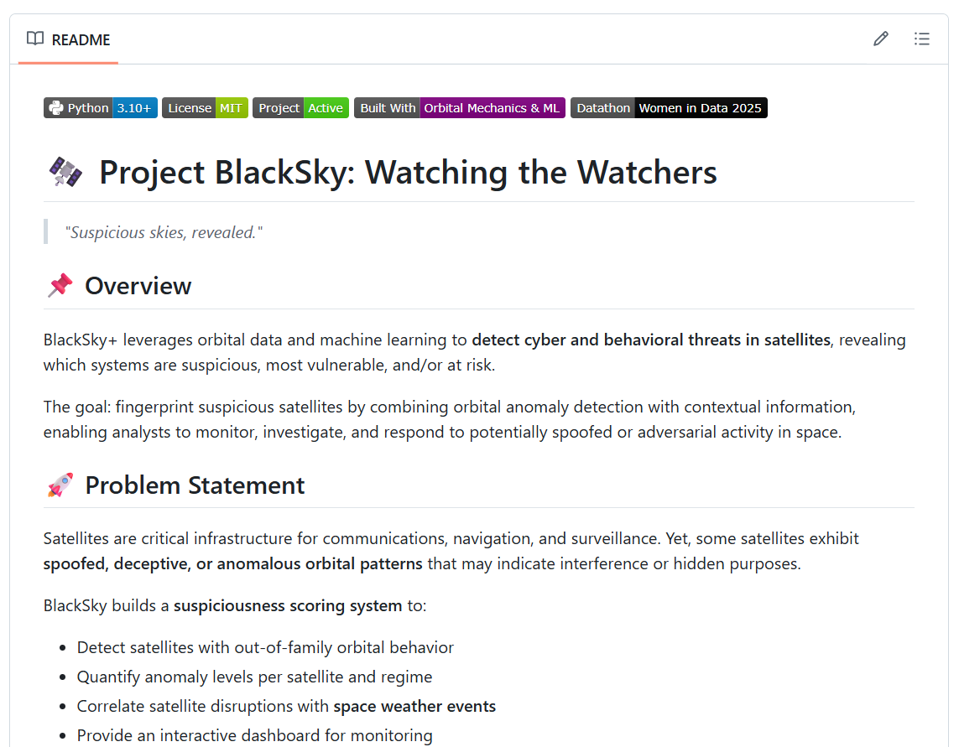

Slide 9

A datathon project by:
Elaine’s Datanauts
Team Members:
Ednalyn C. De Dios
Marwah Obaid
Peace Edwins
Saarah Hossain
Tuhina Chaudhari

